Slide 1

UNIVERSITY MANAGEMENT SYSTEM
21AIE111 DATA STRUCTURES AND ALGORITHMS

Slide 2
OUR TEAM
GROUP NO 13
MEMBERS –
S HARI SANKAR AM.EN.U4AIE21056
R RAKESH AM.EN.U4AIE21052
SAI MANASA SOUMYA AM.EN.U4AIE21057
CHERISHMA AKSHAYA AM.EN.U4AIE21051
K SUBHASH AM.EN.U4AIE21036

Slide 3
TABLE OF CONTENTS
PROPOSED METHODOLOGY
INTRODUCTION
PROBLEM DEFENITION
RESULT
SYSTEM REQUIREMENTS
DATA STRUCTURES USED

Slide 4
INTRODUCTION
PROBLEM STATEMENT
OBJECTIVE

Slide 5
INTRODUCTION
UNIVERSITY MANAGEMENT SYSTEM (UMS) deals with the maintenance of university, college, faculty, student information with the university.
UMS is an automation system, which collects related information from all the departments of an organization and maintains files, which are used to generate reports in various forms to measure individual and overall performance of the students. .

Slide 6

PROBLEM STATEMENT
Most of the schools and colleges are maintain student information in records. When the number of records increased, it is difficult to maintain the information of each student in the old manual system.
The existing system which we using in our college is a traditional process which is a complete manual process.
Maintaining the records manually leads to errors and requires more man power and it consumes more time for processing the records. That’s why we need an automated and easy application for admissions and marks.

Slide 7
OBJECTIVE
To make a automated university management system using various data structures

Slide 8
SYSTEM REQUIREMENTS
SOFTWARE REQUIREMENTS
HARDWARE REQUIREMENTS

Slide 9
SOFTWARE REQUIREMENTS
JAVA DEVELOPMENT KIT
VSC/ IntelliJ Idea/ Eclipse
OFFICE 365 OR WPS OFFICE
Latest version of JDK should be installed in the computer
Any IDE for writing and editing the java program
The information is stored in excel sheet. Hence some kind of excel support should be installed

Slide 10



HARDWARE REQUIREMENTS
OPERATING SYSTEM –
Windows / MAC / Linux
RAM AND MEMORY
Minimum RAM – 4GB
Minimum Storage – 2 GB
PROCESSOR Intel i3 or more

Slide 11


PROPOSED METHODOLOGY
USE CASE DIAGRAM
CLASSES
DATA STRUCTURES USED

Slide 12
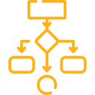
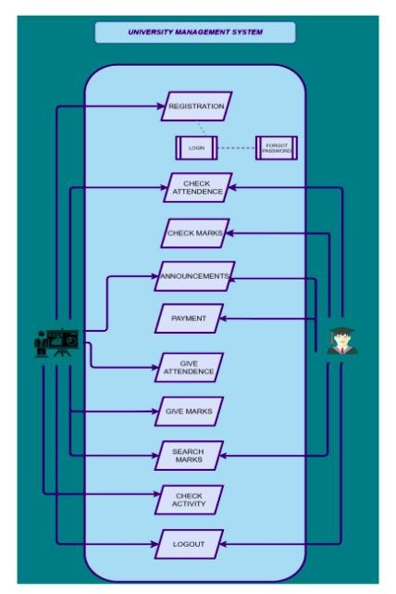
USE CASE DIAGRAM

Slide 13

DATA STRUCTURES USED
ARRAYS
ARRAY LIST
STACK
QUEUE
QUEUE
SET
MAP

Slide 14
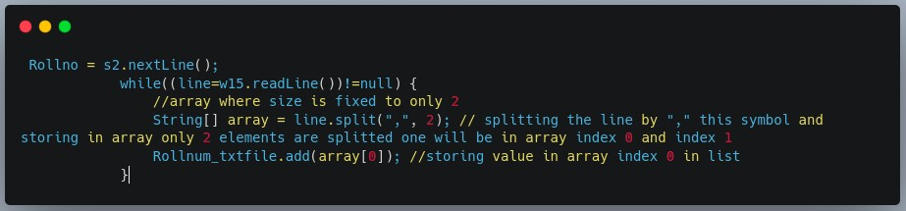
ARRAYS
An array is a collection of items stored at contiguous memory locations. The idea is to store multiple items of the same type together. This makes it easier to calculate the position of each element by simply adding an offset to a base value, i.e., the memory location of the first element of the array (generally denoted by the name of the array).

Slide 15
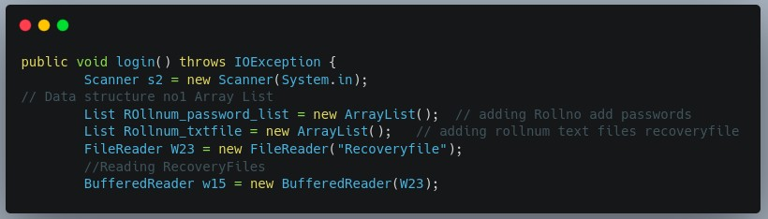
ARRAY LIST
Array List is a part of collection framework and is present in java util package. It provides us with dynamic arrays in Java. Though, it may be slower than standard arrays but can be helpful in programs where lots of manipulation in the array is needed. This class is found in java util package.

Slide 16
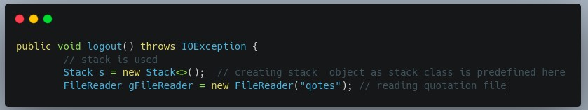
STACK
There are many real-life examples of a stack. Consider an example of plates stacked over one another in the canteen. The plate which is at the top is the first one to be removed, i.e. the plate which has been placed at the bottommost position remains in the stack for the longest period of time. So, it can be simply seen to follow LIFO(Last In First Out)/FILO(First In Last Out) order.

Slide 17
QUEUE
A Queue is a linear structure which follows a particular order in which the operations are performed. The order is First In First Out (FIFO). A good example of a queue is any queue of consumers for a resource where the consumer that came first is served first. The difference between stacks and queues is in removing. In a stack we remove the item the most recently added; in a queue, we remove the item the least recently added.

Slide 18
MAP
A Queue is a linear structure which follows a particular order in which the operations are performed. The order is First In First Out (FIFO). A good example of a queue is any queue of consumers for a resource where the consumer that came first is served first. The difference between stacks and queues is in removing. In a stack we remove the item the most recently added; in a queue, we remove the item the least recently added.

Slide 19
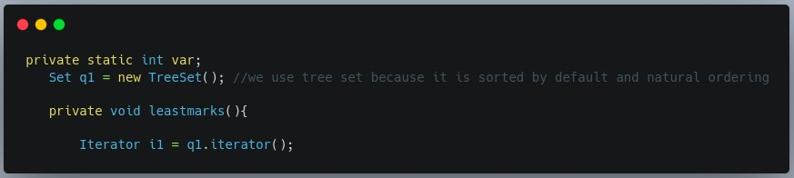
SET
The set interface is present in java.util package and extends the Collection interface is an unordered collection of objects in which duplicate values cannot be stored. It is an interface that implements the mathematical set. This interface contains the methods inherited from the Collection interface and adds a feature that restricts the insertion of the duplicate elements. There are two interfaces that extend the set implementation namely SortedSet and NavigableSet.

Slide 20
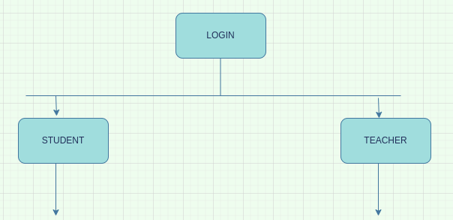
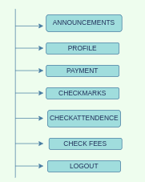
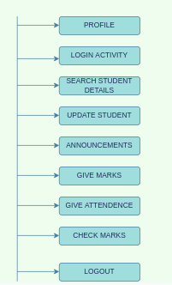
CLASSES USED

Slide 21
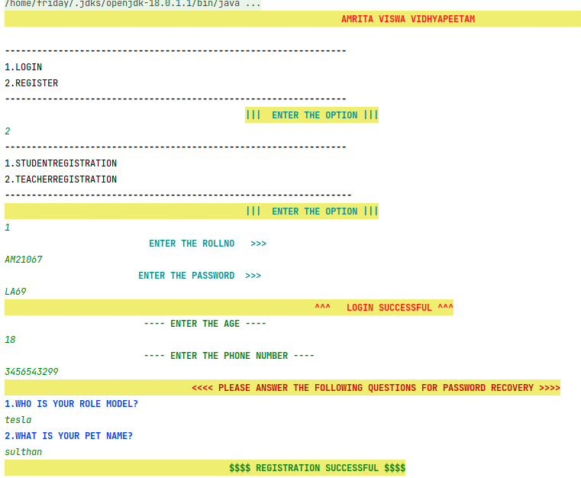
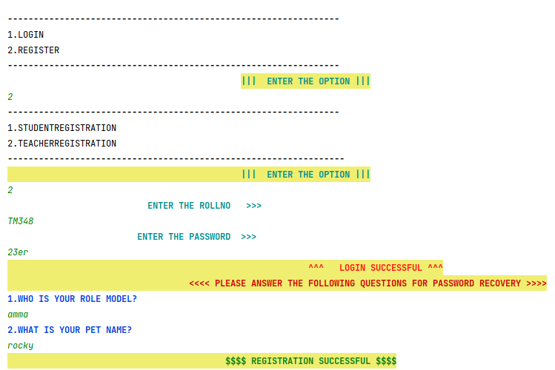
RESULTS

Slide 22
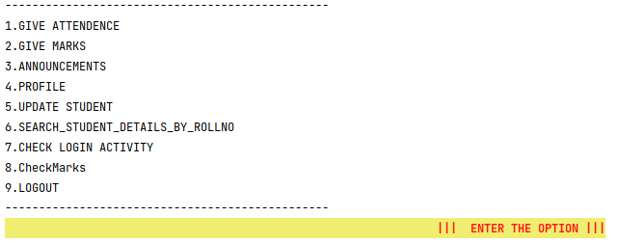
RESULTS

Slide 23
THANK YOU!

